Slide 1

Business Analytics II (BIS 244 – Chapter 5 part 2)
BIS 244 – Fall 2022 – Dr. Davoodi

Slide 2

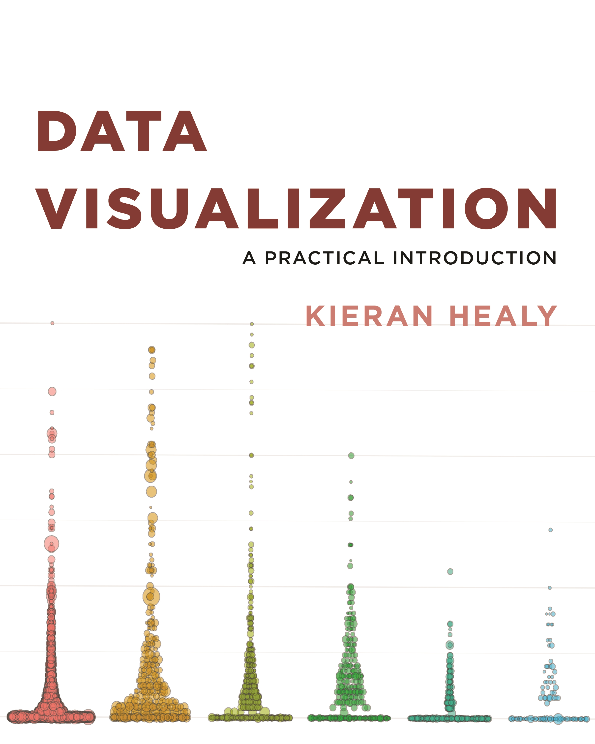
Chapter 5: Graph Tables, Add Labels, Make Notes

Slide 3
Chapter 5
Chapter 5 part 1 focus: expanding the range of things you can do with ggplot.
Using pipe operator %>% to pass a dataframe into a function
Summarizing a data frame and then plot it using geom_bar or Geom_col function
Using facet functions to divide some plots
Using geom_boxplot to compare some Continuous Variables by Group or Category
Using coord_flip() function to rotate a plot

Slide 4
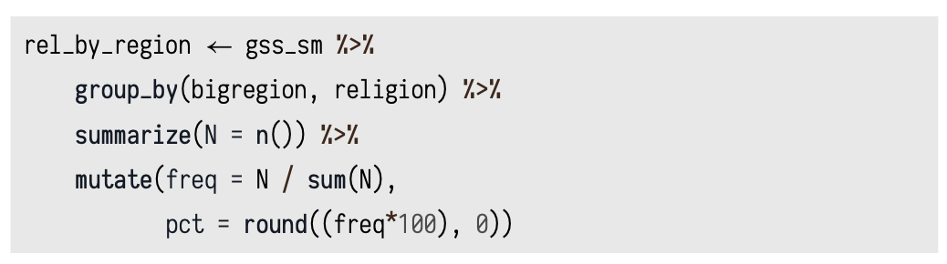
Chapter 5 part 1 Review
facet_grid()
Use Pipes to Summarize Data
%>%: Pipe operator
Group_by() function: Group a datafram by some variables
Summarize() function: Summarize a grouped dataset
Mutate() function: add some columns to your dataset

Slide 5
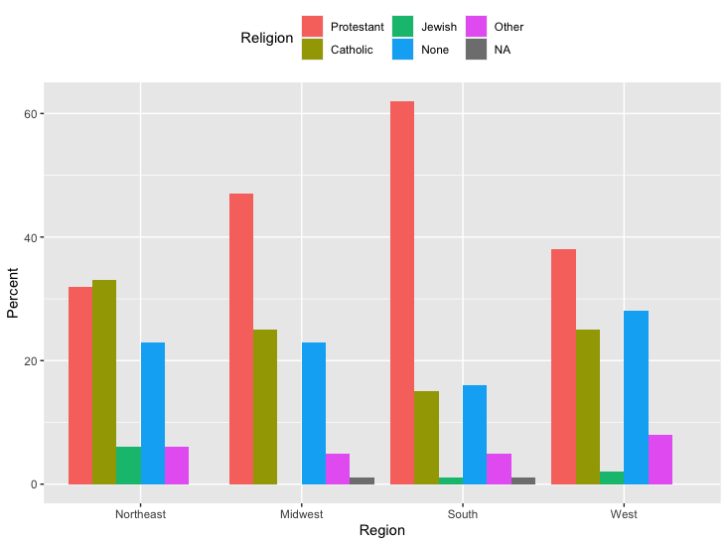
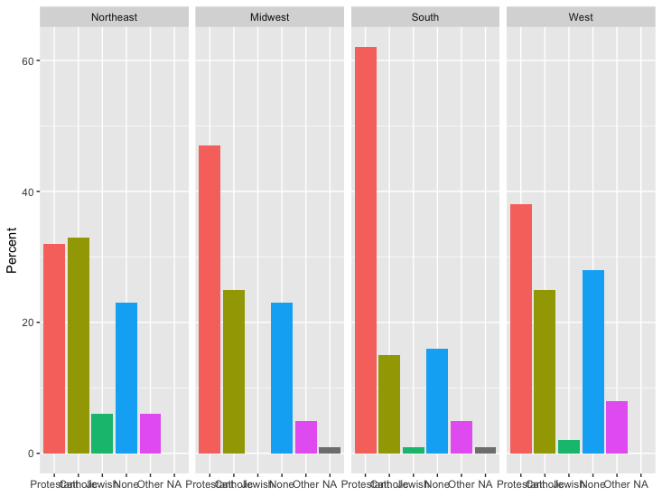
Chapter 5 part 1 Review
Use geom_col() to plot the summarized dataset
Use facet_wrap() to divide the dataset

Slide 6
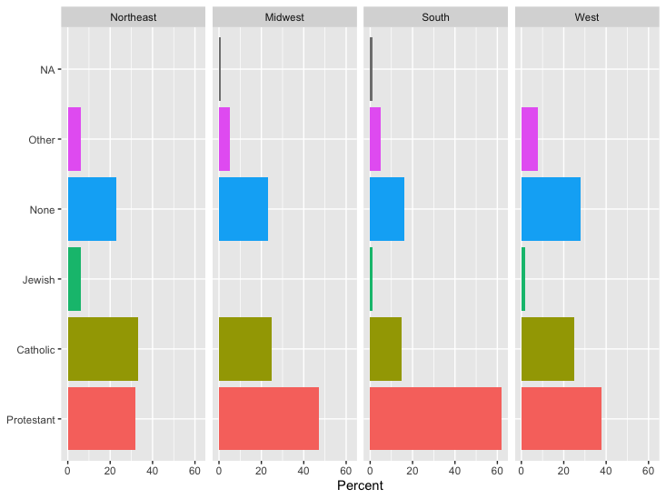
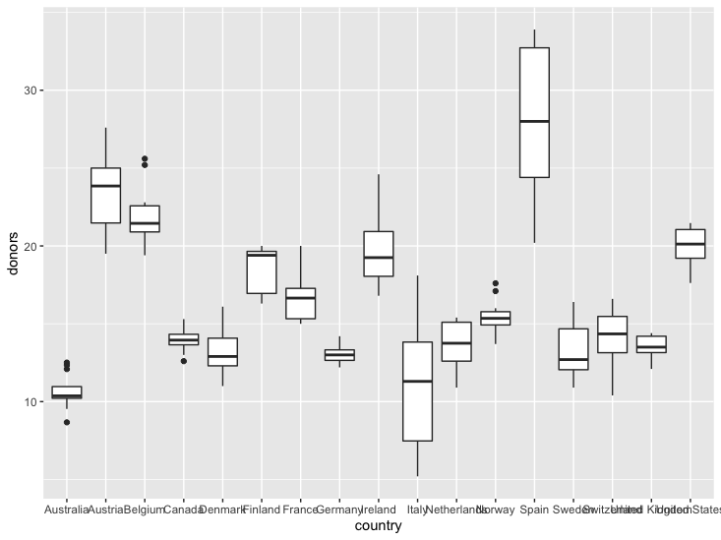
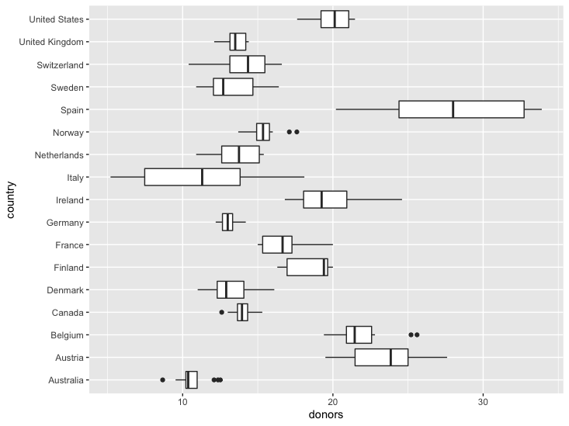
Chapter 5 part 1 Review
Use coord_flip() function to flip a plot
Use Box_plot() function to plot summarize continuous variable for categorical variable

Slide 7
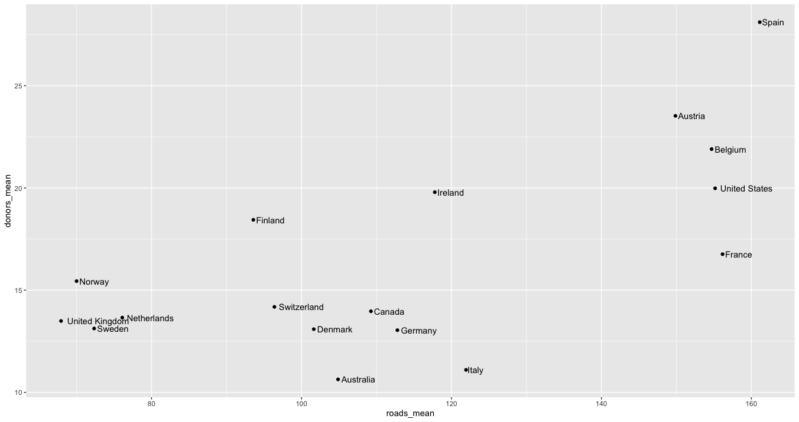
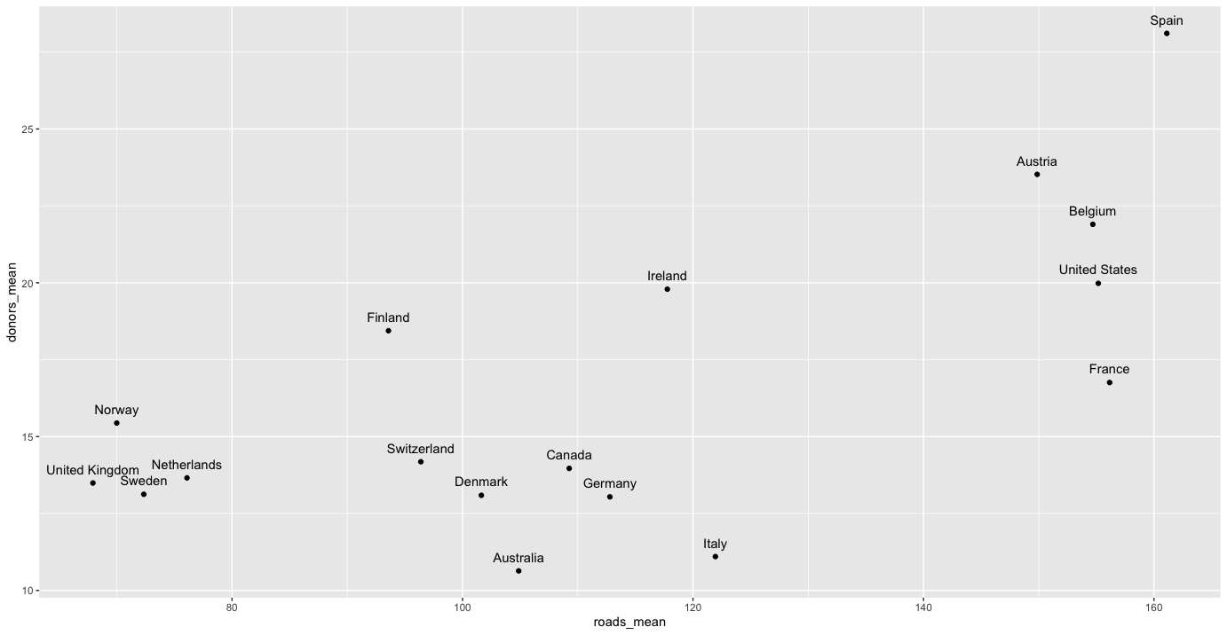
5.3 Plot Text Directly
Find the relationship between road fatalities and donor rate on average
First, summarize the dataset to get the mean for those variables
Second, plot the summarized data
Third, use geom_text().
Label them on the plot to get the relationship
Adjust them as necessary using hjust or vjust

Slide 8
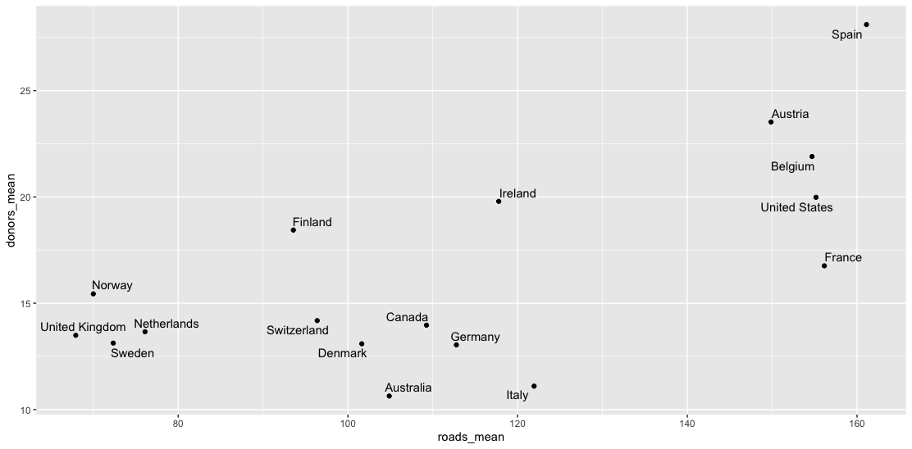
5.3 Plot Text Directly
geom_text() function is not a reliable way of adding labels.
ggrepel is another way of labeling.

Slide 9
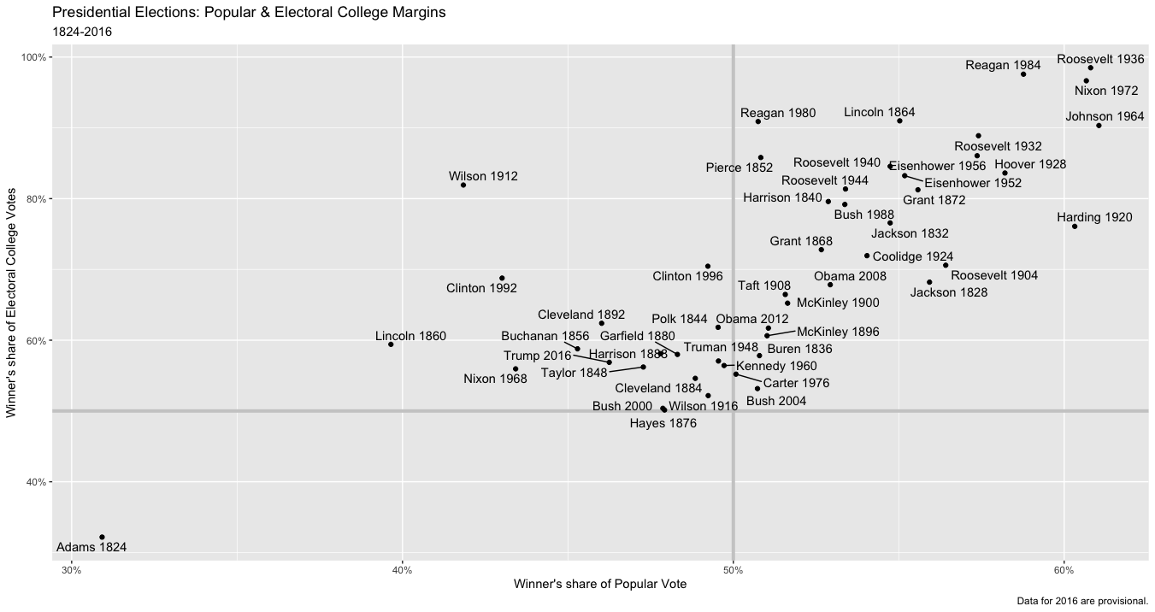
5.3 Plot Text Directly
elections_historic: Historical U.S. presidential election data
Plot the winner’s share of the electoral college vote versus his popular vote

Slide 10
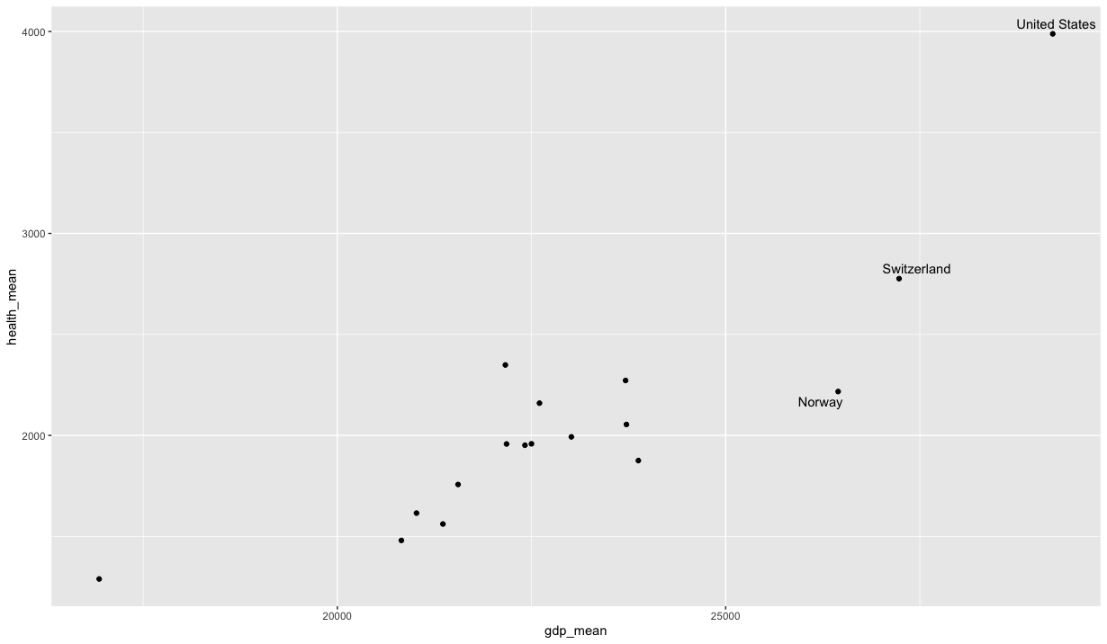
5.4 Label Outliers
Labeling some points of interest in the data without labeling every single item.
Plot the gdp_mean vs health_mean
Label those countries that have gdp > 25000

Slide 11
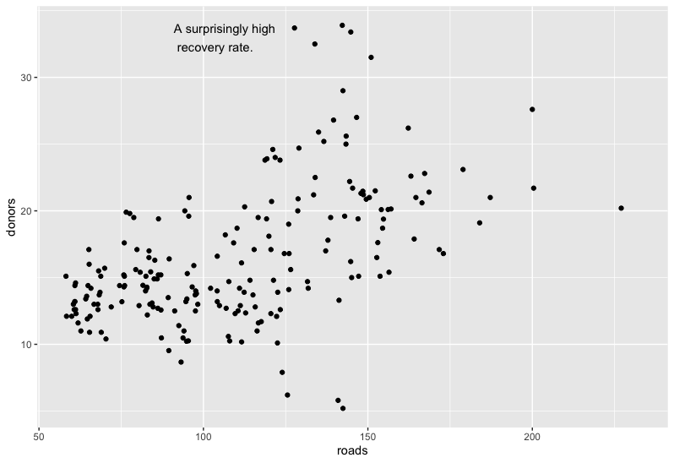
5.5 Write and Draw in the Plot Area
If we want to annotate the figure directly, you use annotate() function.
It is similar to geom_text() regarding arguments
Plot the road fatalities vs. donors
Find something surprising, so annotate it.

Slide 12
5.6 Understanding Scales, Guides, and Themes
In this chapter, we introduced some new geom_ functions
we made use of new functions controlling some aspects of our graph
scale_x_log10(): adjust axis labels
scale_x_continuous(): adjust axis labels
guides(): remove the legends for a color mapping
theme(): move the position of a legend from the side to the top of a figure.

Slide 13
Summary
In chapter 5, we learned how to use
pipe operator to pass a dataframe or tibble to a function
summarize function to create a new dataframe
mutate function to create new columns
ggplot functions like geom_col, geom_boxplot, coord_flip, geom_jitter, and geom_pointrange to visualize some data
How to add label and annotate a plot

